Slide 1
GIS Data Structures
DR PRASENJIT DAS

Slide 2
Representing Geographic Features:
How do we describe geographical features?
by recognizing two types of data:
Spatial data which describes location (where)
Attribute data which specifies characteristics at that location (what, how much, and when)
How do we represent these digitally in a GIS?
by grouping into layers based on similar characteristics (e.g hydrography, elevation, water lines, sewer lines, grocery sales) and using either:
vector data model (coverage in ARC/INFO, shapefile in ArcView)
raster data model (GRID or Image in ARC/INFO & ArcView)

Slide 3
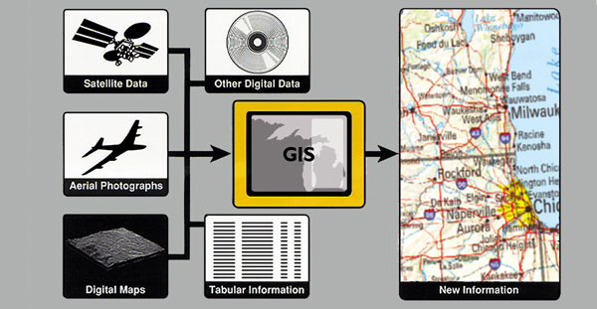
DATA USED IN GIS
Community Resource
Mapping

Slide 4
Spatial Data Types
continuous: elevation, rainfall, ocean salinity
areas:
unbounded: landuse, market areas, soils, rock type
bounded: city/county/state boundaries, ownership parcels, zoning
moving: air masses, animal herds, schools of fish
networks: roads, transmission lines, streams
points:
fixed: wells, street lamps, addresses
moving: cars, fish, deer

Slide 5
Attribute data types
Categorical (name):
nominal
no inherent ordering
land use types, county names
ordinal
inherent order
road class; stream class
often coded to numbers eg SSN but can’t do arithmetic
Numerical
Known difference between values
interval
No natural zero
can’t say ‘twice as much’
temperature (Celsius or Fahrenheit)
ratio
natural zero
ratios make sense (e.g. twice as much)
income, age, rainfall
may be expressed as integer [whole number] or floating point [decimal fraction]
Attribute data tables can contain locational information, such as addresses
or a list of X,Y coordinates.

Slide 6
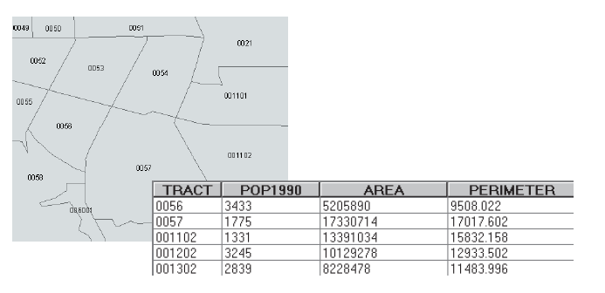
Attribute Data Structure
Attribute table
“Flat File” with columns and rows
Row = geographic feature record
Column = attribute field (item of information about a feature)

Slide 7
Data Base Management Systems (DBMS)
entity
Key field
Attribute
Contain Tables or feature classes in which:
rows: entities, records, observations, features:
‘all’ information about one occurrence of a feature
columns: attributes, fields, data elements, variables, items (ArcInfo)
one type of information for all features
The key field is an attribute whose values uniquely identify each row

Slide 8
GIS Data Models: Raster v. Vector “raster is faster but vector is corrector” Joseph Berry
Raster data model
location is referenced by a grid cell in a rectangular array (matrix)
attribute is represented as a single value for that cell
much data comes in this form
images from remote sensing (LANDSAT, SPOT)
scanned maps
elevation data from USGS
best for continuous features:
elevation
temperature
soil type
land use
Vector data model
location referenced by x,y coordinates, which can be linked to form lines and polygons
attributes referenced through unique ID number to tables
much data comes in this form
DIME and TIGER files from US Census
DLG from USGS for streams, roads, etc
census data (tabular)
best for features with discrete boundaries
property lines
political boundaries
transportation

Slide 9
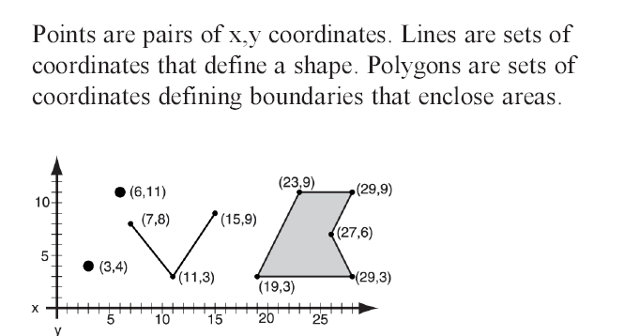
Vector Data Structure
polygons
lines

Slide 10
Vector Data Structure
In vector data layers, the feature layer is linked to an attribute table. Every individual feature corresponds to one record (row) in the attribute table.

Slide 11
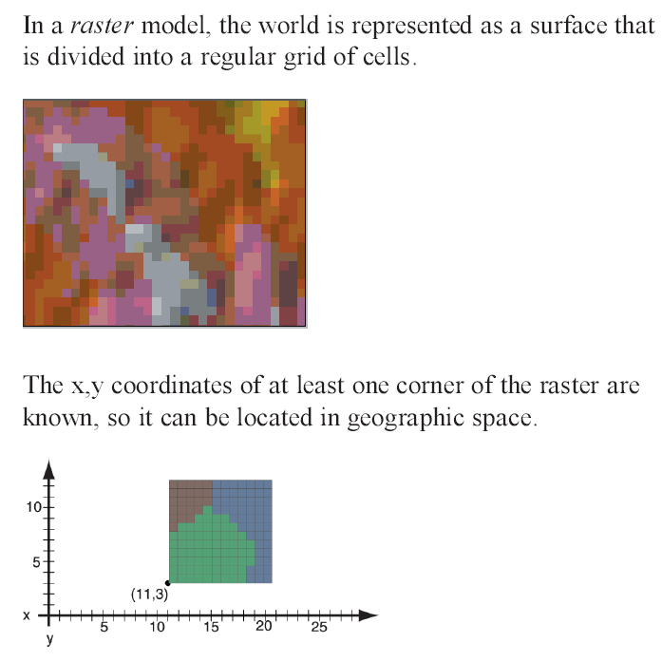
Raster Data Structure (Grid)

Slide 12
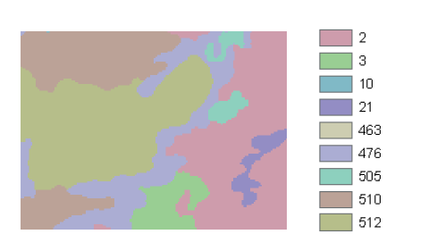
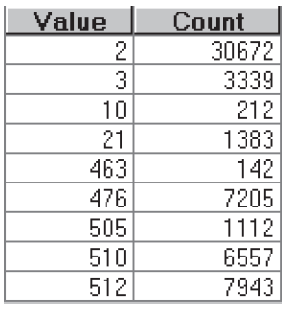
Raster Data Structure
A raster grid can store values that represent categories, for example, vegetation type
The basic grid attribute table has a value and count field
The value field has a code or some real number representing information about the grid cell. In this case it is a code for vegetation.
The count field shows how many grid cells have that same value.

Slide 13
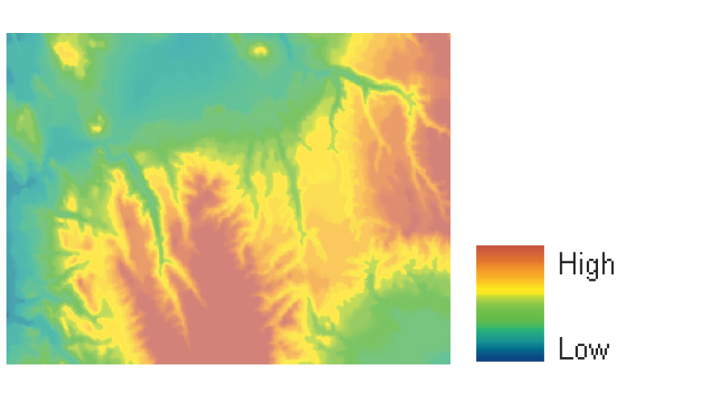
Raster Data Structure
Grids can also store continuous values like elevation

Slide 14
Raster Data Structure
Elevation grid for area north of Kirkuk, Iraq
From space shuttle radar topography mission (SRTM)
Zoom in and you see the grid cells
These are called:
Digital Elevation Models (DEM)

Slide 15
Raster Data Structure
So 2 ways of representing elevation:
Vector contour lines
Raster grid

Slide 16
IRS LISS III Image
(FCC)
Mathanguri I.B.
Manas National Park
Bansbari Range Office
Satellite Imagery of Manas National Park

Slide 17
Dense Forest
River
Water Body
Open Forest
Settlement
Agriculture
Fallow Land
Typical Tone and Texture of Common Features

Slide 18
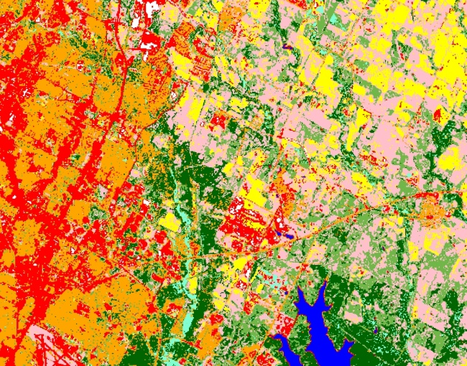
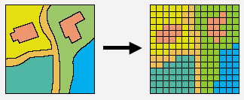
Raster Data Structure
Sources of raster data
Interpreted satellite imagery, e.g., land cover
Conversion of vector to raster data

Slide 19
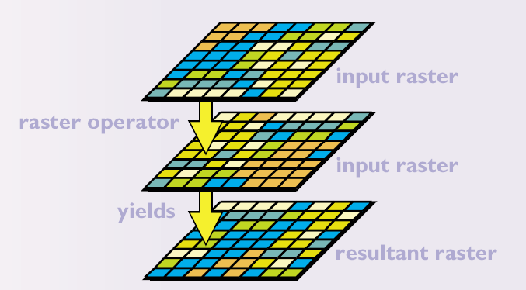
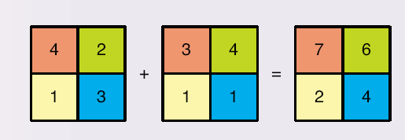
Raster Data Structure

Slide 20
Raster and Vector Data Structures
Raster data are described by a cell grid, one value per cell
Vector
Raster
Point
Line
Zone of cells
Polygon
Notes:
DRM

Slide 21
Comparison Between Vector and Raster Data Model
Advantages
It is a simple data structure
Overlay operations are easily and efficiently implemented
High spatial variability is efficiently represented in a raster format
The raster model is more or less required for efficient manipulation and enhancement of digital images
Disadvantages
The raster data structure is less compact data compression techniques (an often overcome this problem)
Topological relationships are more difficult to represent
The output of graphics is less aesthetically pleasing because appearancerather than the smooth lines of hand-drawn maps. This can be overcome by using a very large number of cells, but may result in unacceptably large files

Slide 22
Comparison Between Vector and Raster Data Model
Advantages
It provides a more compact data structure than the raster model
It provides efficient encoding of topology and as a result more efficient implementation of operations that require topological information, such as network analysis
The vector model is better suited to supporting graphics that closely approximate hand-drawn maps
Disadvantages
It is a more complex data structure than a simple raster
Overlay operations are more difficult to implement
The representation of high spatial variability is inefficient
Manipulation and enhancement of digital images cannot be effectively done in the vector domain

Slide 23
Concept of
Vector and Raster
Real World
Raster Representation
Vector Representation
point
line
polygon

Slide 24
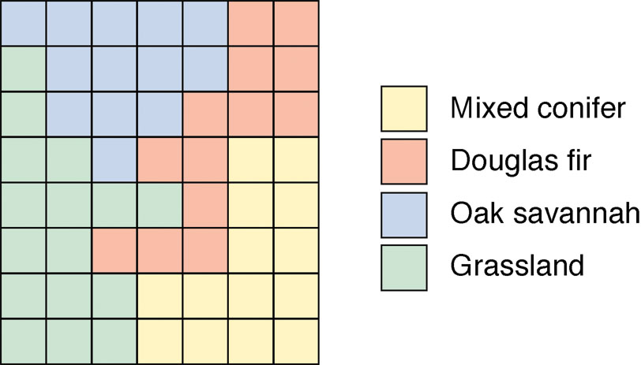
Raster representation
Each color represents a different value of an integer variable denoting land cover class

Slide 25
Vector Data
Camp Location -Point Feature
Drainage - Line Feature
Boundary - Polygon Feature
Satellite Imagery – Raster Data
Vectorization of Kazironga National Park Boundary
,

Slide 26
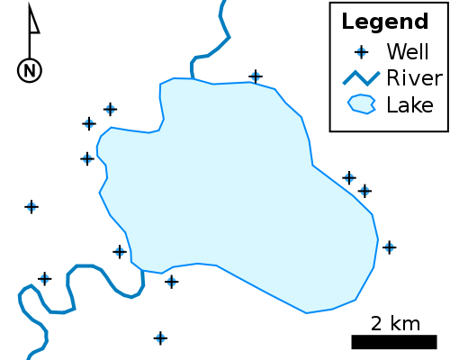
Object/Vector Feature Types

Slide 27
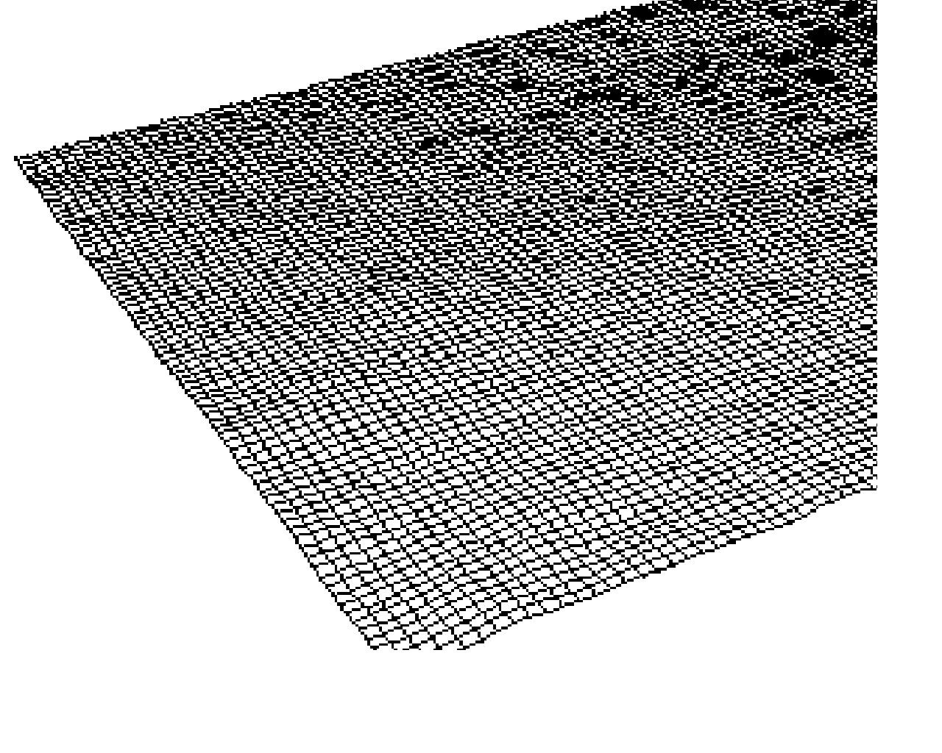
Digital Elevation Model
a sampled array of elevations (z) that are at regularly spaced intervals in the x and y directions.
two approaches for determining the surface z value of a location between sample points.
In a lattice, each mesh point represents a value on the surface only at the center of the grid cell. The z-value is approximated by interpolation between adjacent sample points; it does not imply an area of constant value.
A surface grid considers each sample as a square cell with a constant surface value.
Advantages
Simple conceptual model
Data cheap to obtain
Easy to relate to other raster data
Irregularly spaced set of points can be converted to regular spacing by interpolation
Disadvantages
Does not conform to variability of the terrain
Linear features not well represented

Slide 28
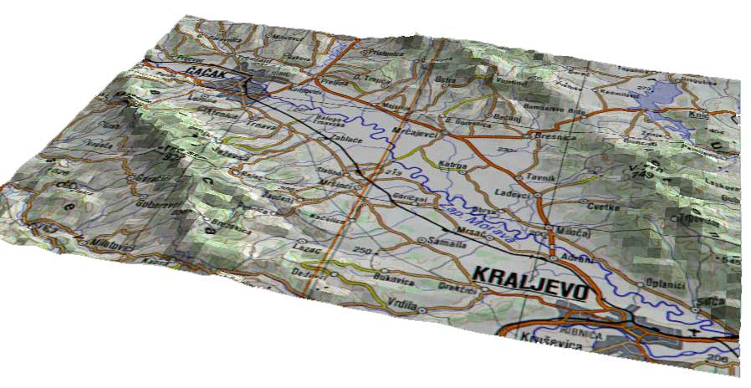
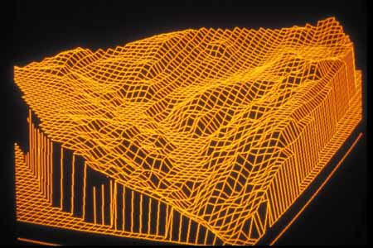
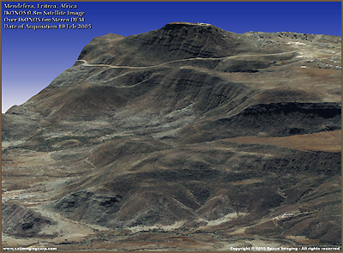
What is a Digital Elevation Model?

Slide 29
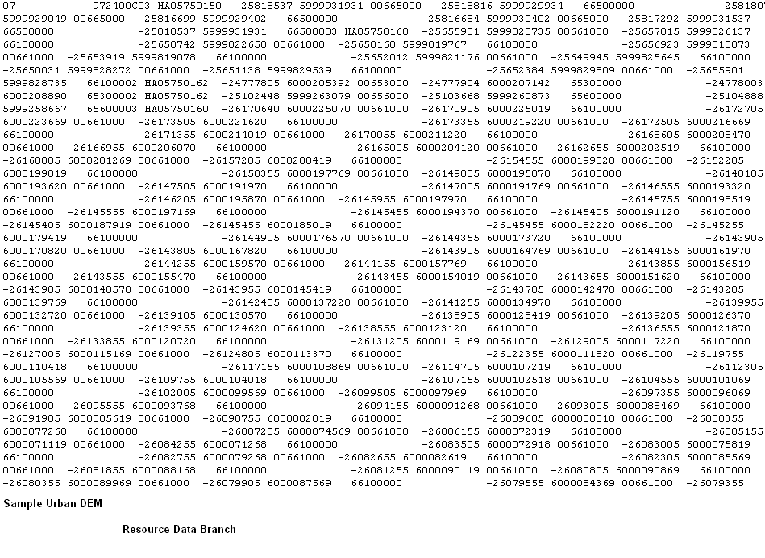
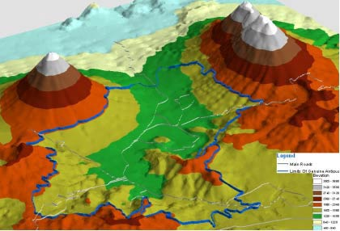
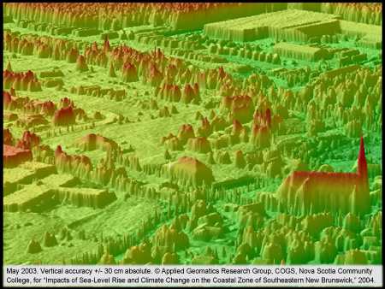
Digital Elevation Models, con’t.

Slide 30
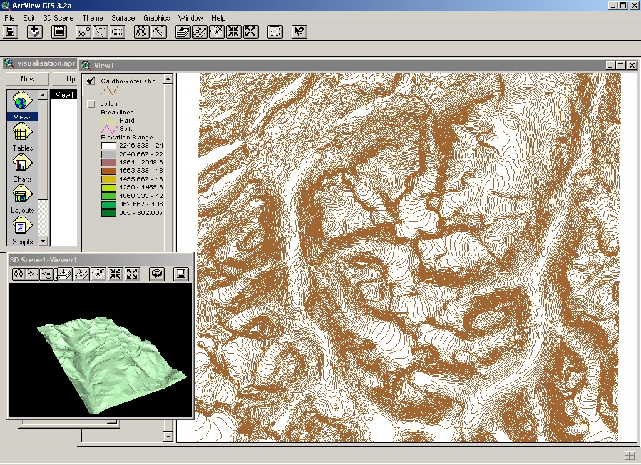
Digital terrain analyses –
DEM principles

Slide 31
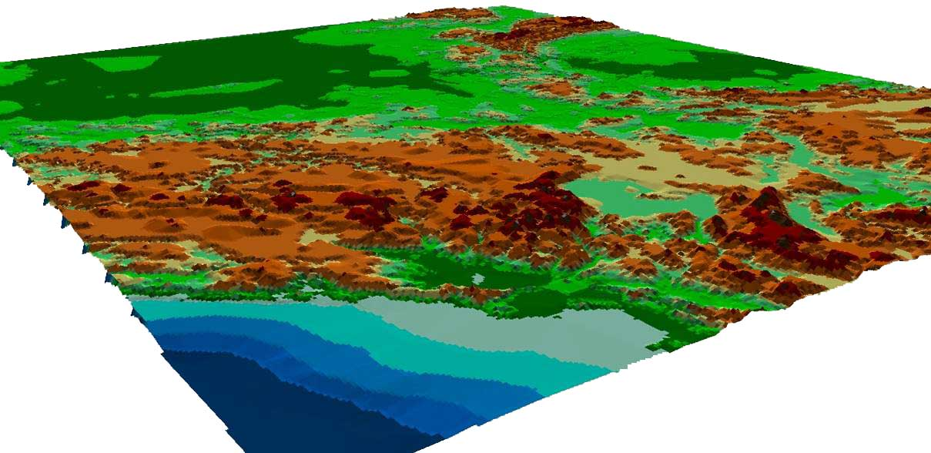
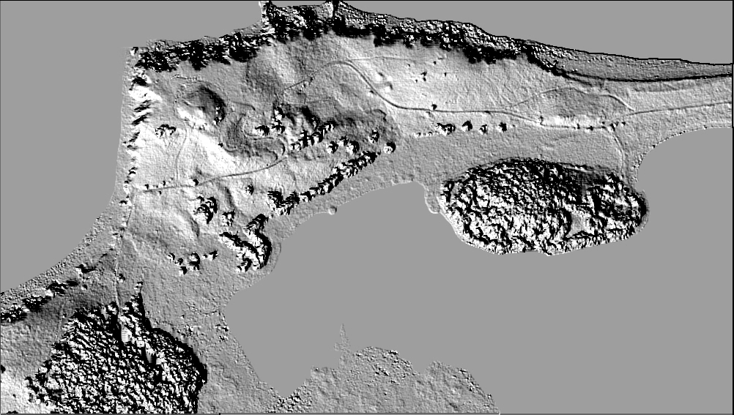
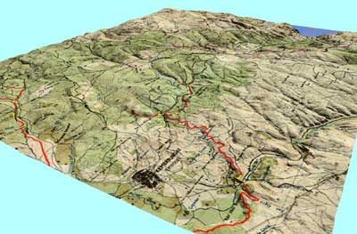
Three terms (DEM,DSM,DTM) for the same thing?
Digital Elevation Model (DEM)
Digital Surface Model (DSM)
Digital Terrain Model (DTM)

Slide 32
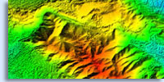
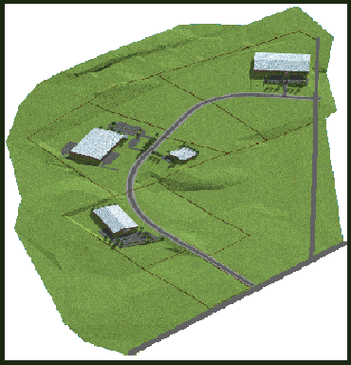
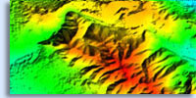
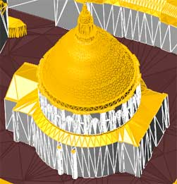
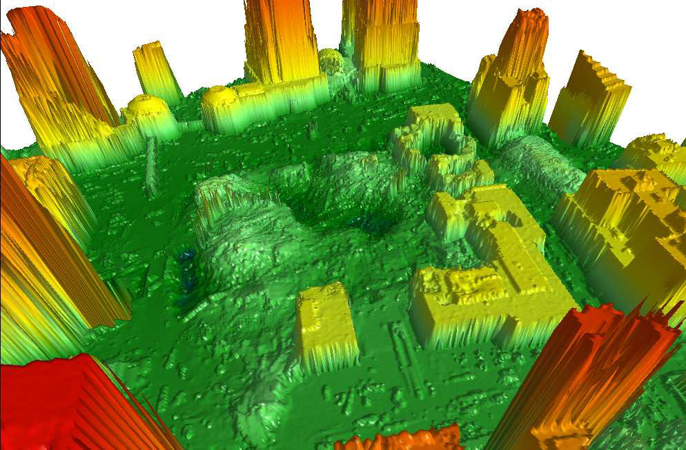
…DIFFERENCE BETWEEN DSM, DTM AND DEM
Digital Surface Model (DSM) is a first surface view of the
earth containing both location and elevation information.
A Digital Elevation Model (DEM) is any DIGITAL representation of ground surface
topography or terrain.
Digital Terrain Model (DTM), aka "bare earth" as it is
often referred, is created by digitally removing all of the
cultural features inherent to a DSM by exposing the
underlying terrain.
)

Slide 33
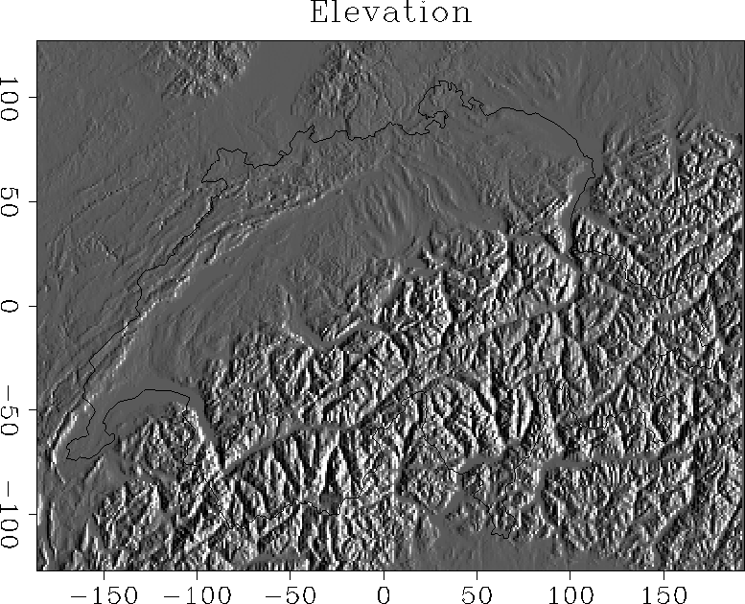
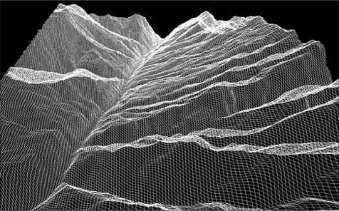
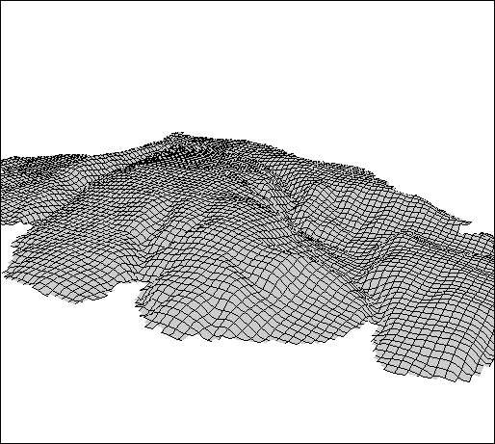
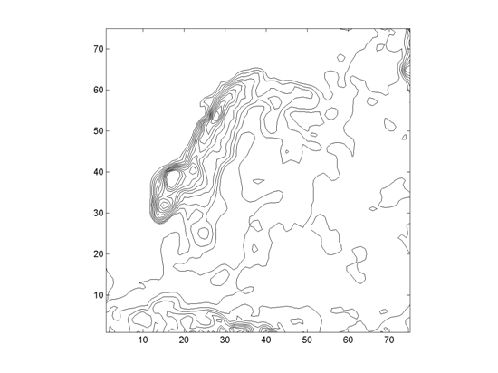
Digital Elevation Models, con’t.

Slide 34
Creation of DEM’s
Conversion of contour lines
Photogrammetry
Satellite Stereo
Radar Stereo
Radar Inferometry
Laser Altimetry

Slide 35
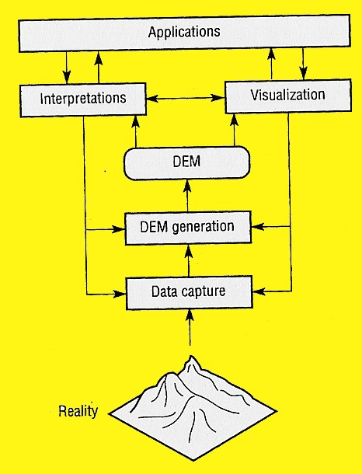
DEM principles

Slide 36
Digital Elevation Models

Slide 37
Uses of DEMs
Determine aspects of terrain
Slope, aspect, spot elevations
Source for contour lines
Finding terrain features
Watersheds,drainage networks, stream channels
Modeling of hydrologic functions

Slide 38
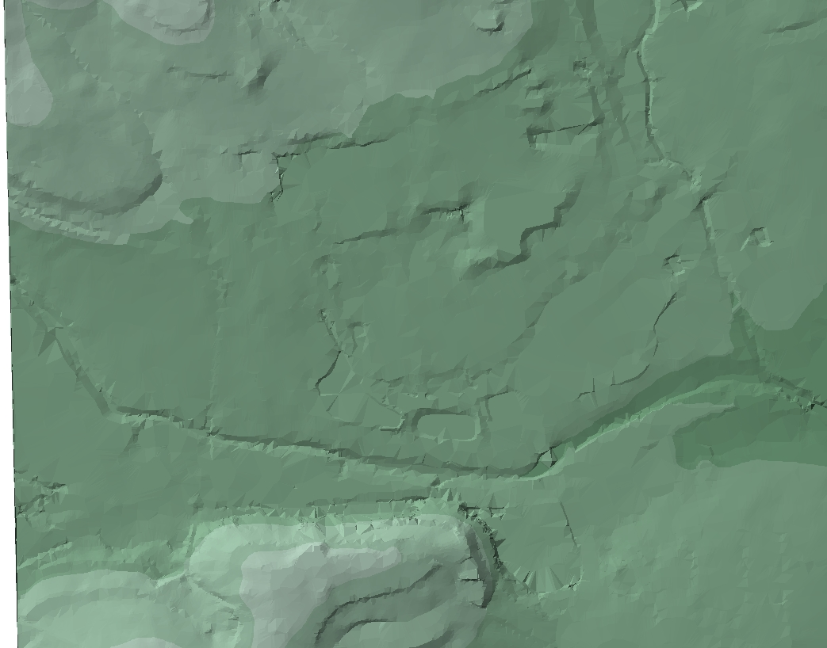
TIN Data Structure
A 3rd data structure for representing surfaces:
Triangulated Irregular Network (TIN)

Slide 39
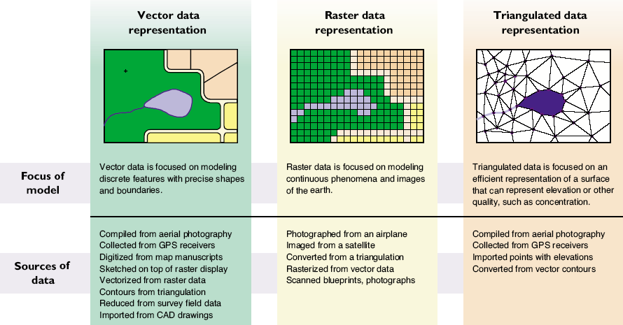
3 GIS Spatial Data Structure Types

Slide 40
Triangulated Irregular Network
a set of adjacent, non-overlapping triangles computed from irregularly spaced points, with x, y horizontal coordinates and z vertical elevations.
Advantages
Can capture significant slope features (ridges, etc)
Efficient since require few triangles in flat areas
Easy for certain analyses: slope, aspect, volume
Disadvantages
Analysis involving comparison with other layers difficult

Slide 41
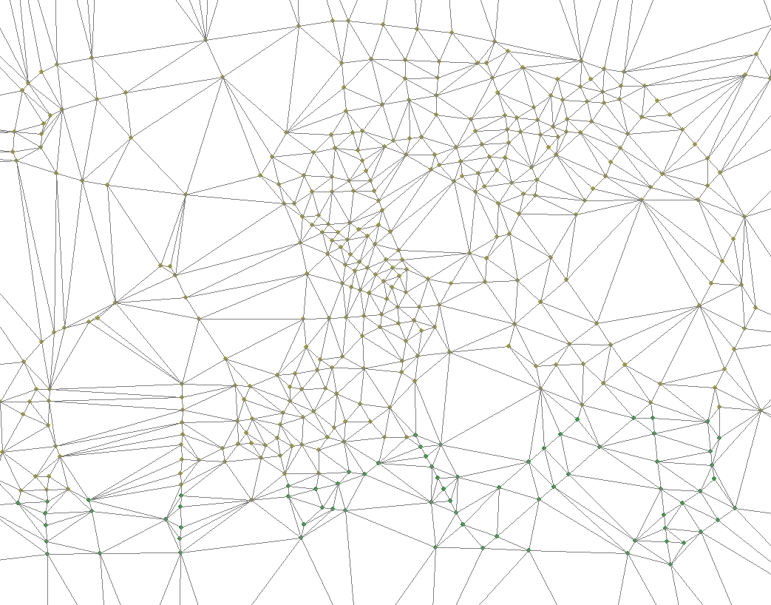
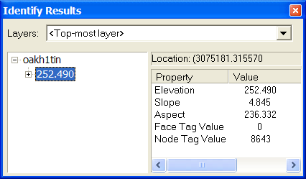
TIN Data Structure
Elevation points connected by lines to form polygons that contain topographic information

Slide 42
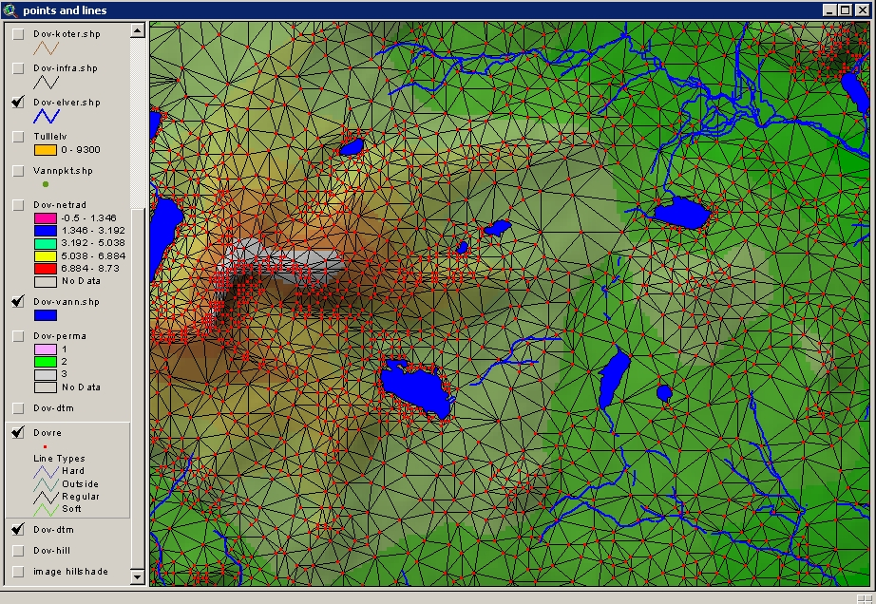
Continuous fields –
TIN
(Triangular irregular network)

Slide 43
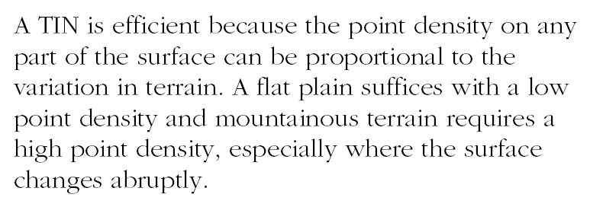
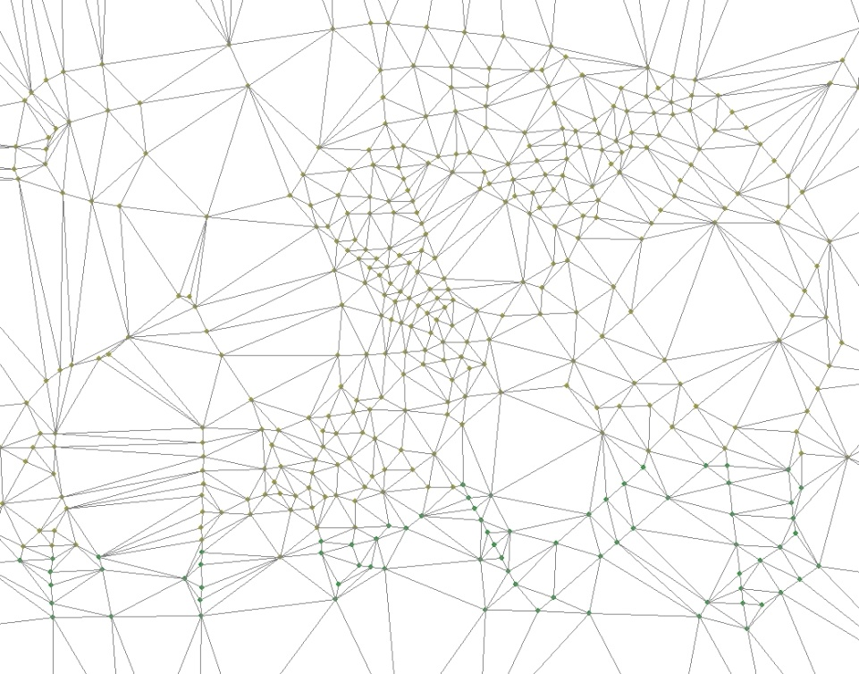
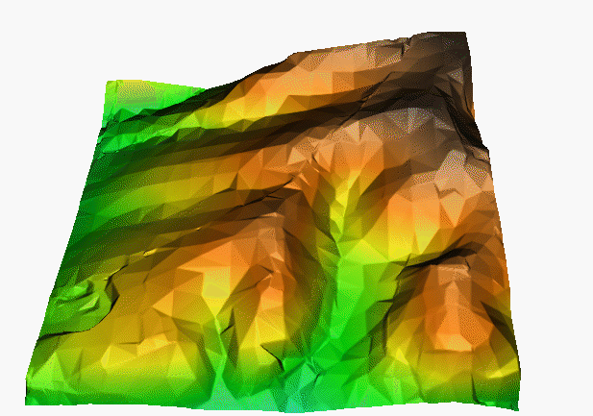
TIN Data Structure

Slide 44
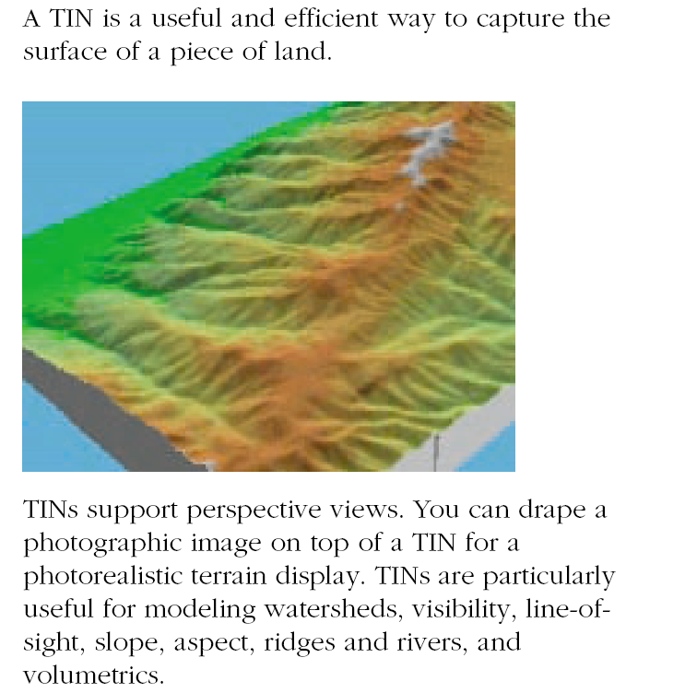
TIN Data Structure

